Slide 1

BUILDING RELATIONSHIP WITH PATIENT AND SOCIETY
*Nurses are responsible for total patient care such as physical care,performing technical procedure, creating safe and comfortable environment etc
*To perform all these activities the nurse needs to build a therapeutic relationship with the patient

Slide 2
Qualities required for a nurse to build a therapeutic relationship
*Competence in knowledge and skill
*Competence in soft skills and communication skills
*Honesty/genuineness
*Trust
*Empathy
*Confidentiality
*Showing respect and caring attitude

Slide 3

Competence in knowledge and skill
*It is the ability to perform activities effectively and efficiently.
*Nurses should have adequate knowledge and skills in performing their roles and responsibilities.
*By being knowledgeable and skillful in nursing practice the nurse begins to gain patient's trust and making him feel more safe

Slide 4
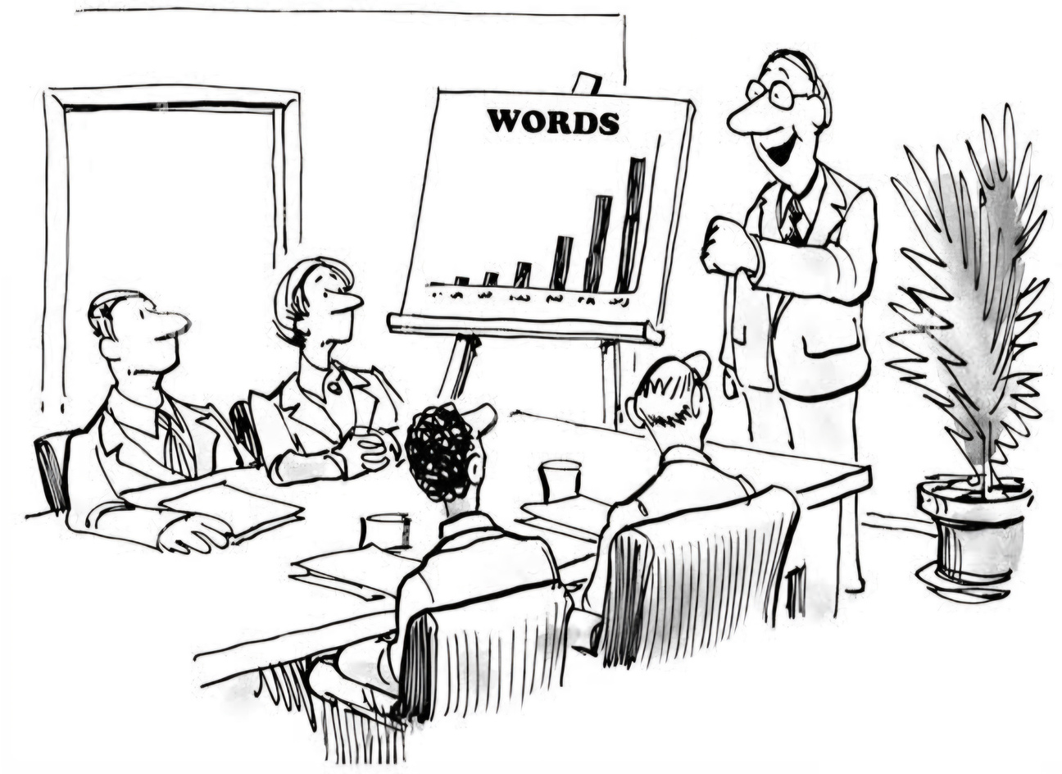
competence in soft skills and communication skills
*To establish a good relationship with the patient, the nurses are required to have effective communication skills.
*These skills include
-being aware of verbal and non-verbal cues of patients
-active listening to patient without interruption
-giving information
-having a non-judgmental approach
-paraphrasing
-summarizing and clarifying information
*All these techniques help build a trusting relationship with the patient

Slide 5

Honesty
-doing the right thing in a right way
-coming to work on time
-not skipping on patient care -admitting to mistakes made and facing the consequences
-not gossiping about the patients and being true to ones beliefs.
*An honest approach will allow the patient to develop respect and a belief that the nurse is acting in his best interest

Slide 6
Trust
*Trust is the main element of all interpersonal relationships. *Some of the nursing activities which facilitate trust are
-active listening
-respecting
-being honest and consistent in activities
-having an acceptable attitude
*If the patient develops trust on the nurse they are more likely to share and disclose information.
*Performing roles in an ethical way is essential to building a trusting relationship with the patient.

Slide 7


*This process allows the nurse to see the suffering from patient's own point of view without experiencing the emotional content.
* This understanding allows the nurse to identify the patient's problems more precisely, set goals for the patient, provide specific interventions and evaluate patient
Empathy

Slide 8

Confidentiality
*refrain from sharing confidential information with others and respecting privacy
*Nurses have the moral obligation of keeping the patient information confidential and not sharing it with others
*confidentiality indicates :
-maintaining privacy in a physical setting while dealing with sensitive issues concerning the patient.
-closing the room door or at least using the separation screen when sharing sensitive information
-Keeping the patient information confidential includes not speaking about the patient and his condition in public places where it could be ovetheard
-strictly limiting /removing mobile phones from patient areas to avoid malicious or accidental recording of private records or information.

Slide 9
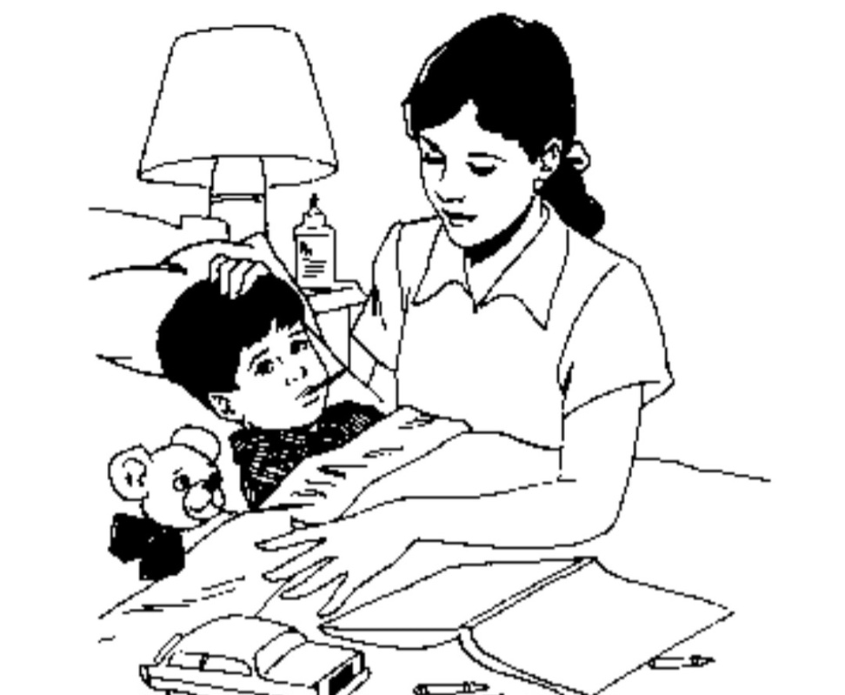
showing respect and caring attitude
*these refer to
-introducing one self, calling the patient with his/her formal name,
-treating the patient with dignity
-arranging for patient comfort and privacy at all times
-preparing the patient before any procedure
-encouraging the patient to make choices regarding his care
-being compassionate
-spending appropriate time with patient
-helping and advising the patient to resolve his problems and demonstrating active listening.
*These activities improve professional relationship with the patient.

Slide 10

Way of communication
Communication can take many forms, depending on the context and the medium used. Here are the main types of communication:
1. Verbal Communication
Face-to-Face: Talking directly with someone.
Phone Calls/Video Calls: Talking remotely using technology.
Meetings/Speeches: Formal or informal speaking engagements.

Slide 11



2. Non-Verbal Communication
Body Language: Gestures, posture, and facial expressions.
Eye Contact: Shows confidence, attention, or emotion

Slide 12
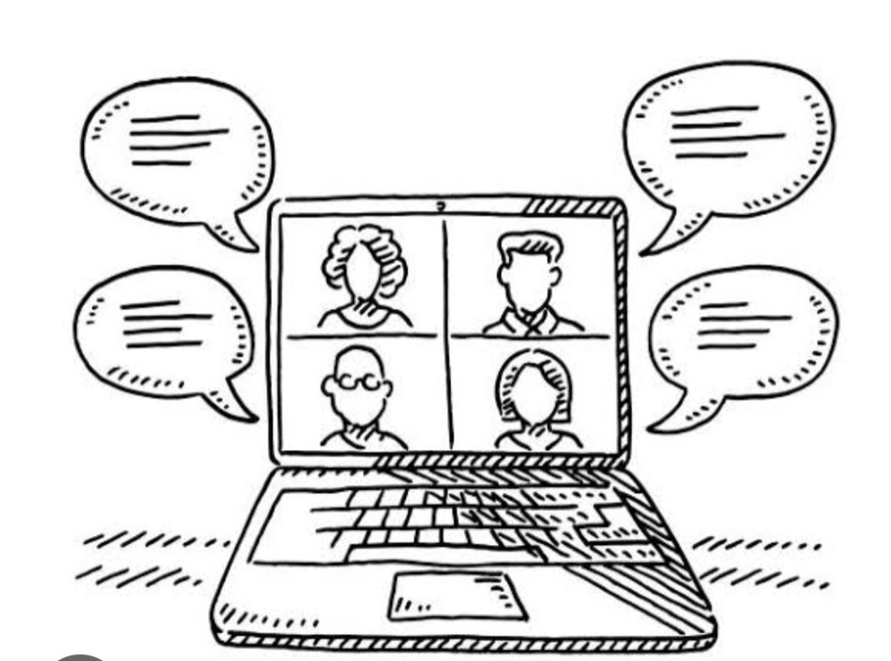

Tone of voice : The way words are spoken can change their meaning
Non verbal communication may more accurately reveal patient feelings than verbal communication.

Slide 13
Thankyou

